Slide 1
CS F320 Foundations of data sciene
Assignment #2 Presentation Template
Group #8
Group Details (2017B2A10548P-VISHESH MANGLA)

Slide 2
Problem Statement- Time-series Classification - Occupancy Detection
Apply different techniques (at least 2) to classify time-series data to predict occupancy in an office room. The variables involved are:
1. date time year-month-day hour:minute:second
2. Temperature, in Celsius
3. Relative Humidity, %
4. Light, in Lux
5. CO2, in ppm
6. Humidity Ratio, Derived quantity from temperature and relative humidity, in kgwatervapor/kg-air
7. Occupancy, 0 or 1, 0 for not occupied, 1 for occupied status

Slide 3
Datasets used
Dataset: http://archive.ics.uci.edu/ml/datasets/Occupancy+Detection+#
train <- read.csv("datatraining.txt")
test1 <- read.csv("datatest.txt")

Slide 4
Data Description
Columns present initially:
date
Temperature
Humidity Light
CO2
HumidityRatio
Occupancy

Slide 5
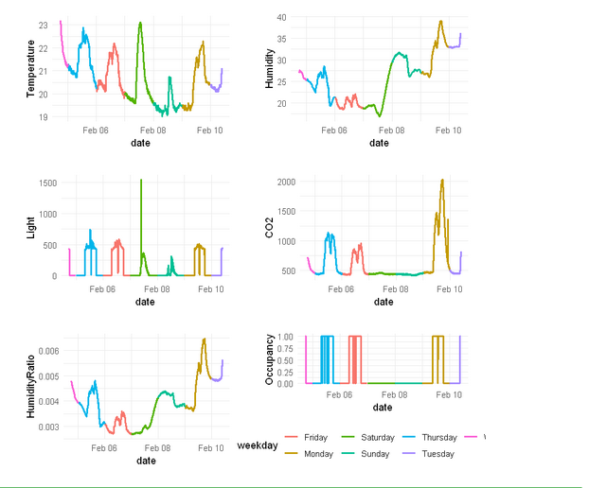
Time series analysis – similarity measures
Occupancy is 0 on Saturday and Sunday. Holidays!

Slide 6
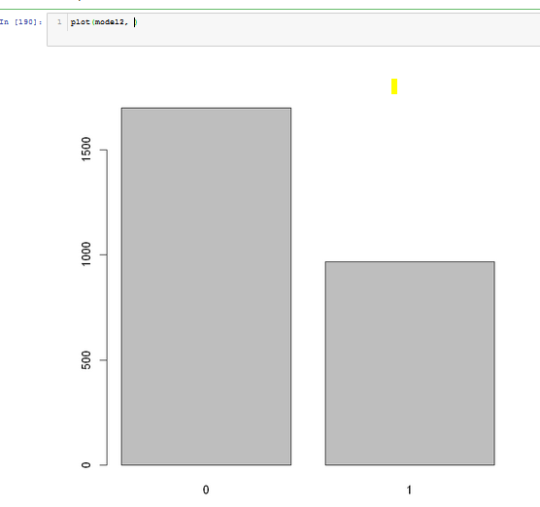
Time series analysis – classification techniques
KNN
sum(ifelse(knn(train[2:6], test[2:6], cl=train$Occupancy, k=2)==test$Occupancy,1,0))
Gives 95% Accuracy

Slide 7
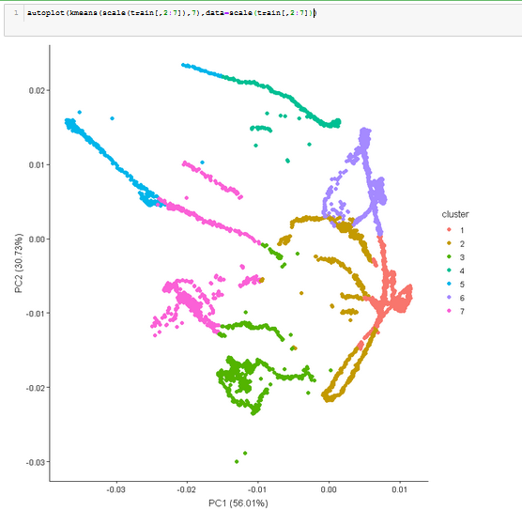
Time series analysis – clustering techniques
K Means Clustering – on basis of weekdays

Slide 8
Techniques used for occupancy detection
Logistic Regression

Slide 9
Preprocessing
Added column corresponding to weekdays using lubridate package
Normalized data using scale function

Slide 10
Details of Techniques used for occupancy detection
'Accuracy of logit regression: 69.2307692307692 %'
Coefficients:
(Intercept) Temperature Humidity Light
0.31080 -0.03178 0.46194 0.35308
CO2 HumidityRatio weekdayMonday weekdaySaturday
0.16490 -0.46724 -0.20546 -0.13830
weekdaySunday weekdayThursday weekdayTuesday weekdayWednesday
-0.24802 0.02620 -0.07530 0.15117

Slide 11
Results/findings & Comparisons (in the form of graphs & tables)

Slide 12
Submit your presentation and R code to Dr. vishal gupta through mail Deadline: 06th April, 2019
Subject line: Group #8

